Slide 1
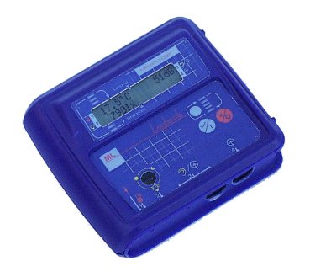
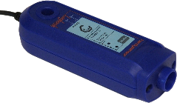
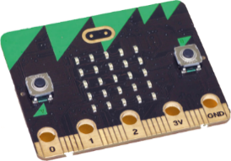
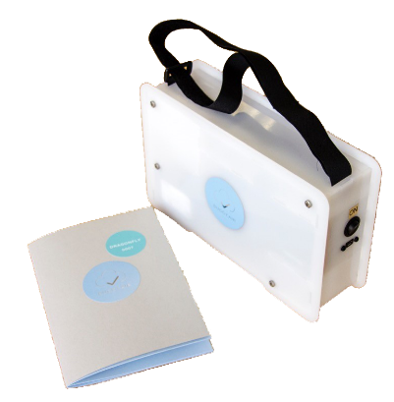
ScienceScope
CEO David Crellin
Developed a range of over 50 sensors
Lead Project Distance to create the IOT@School followed by projects in Peterborough and Singapore
Tier 1 partner for the BBC micro:bit
Developing Buggy Air (Air Quality monitoring)

Slide 2
Projects
ScienceScope projects:
Distance (Internet of School Things)
IOT@School for Singapore
Buggy air
BBC micro:bit

Slide 3
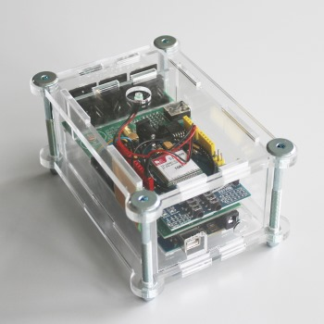
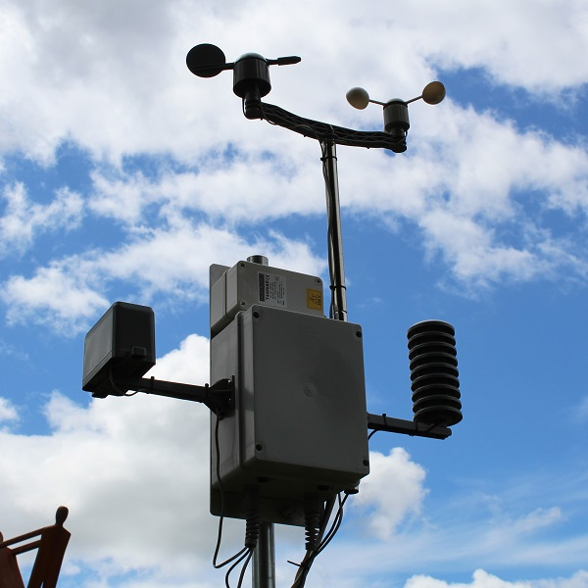
Devices and Sensors

Slide 4
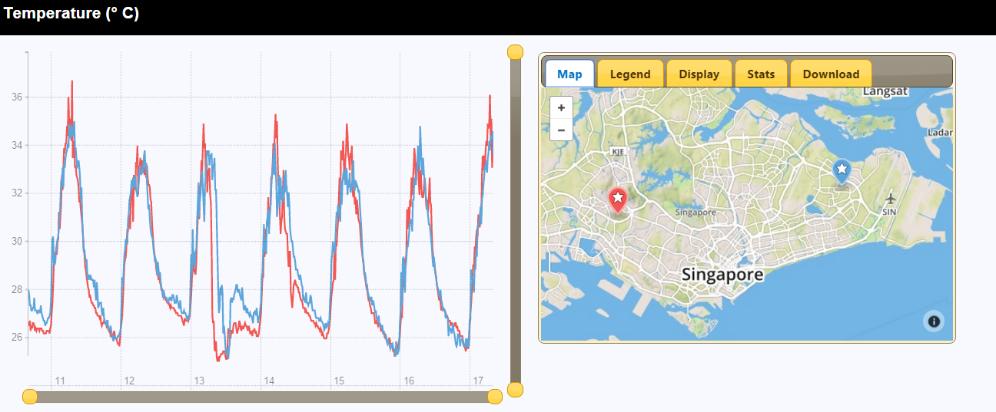
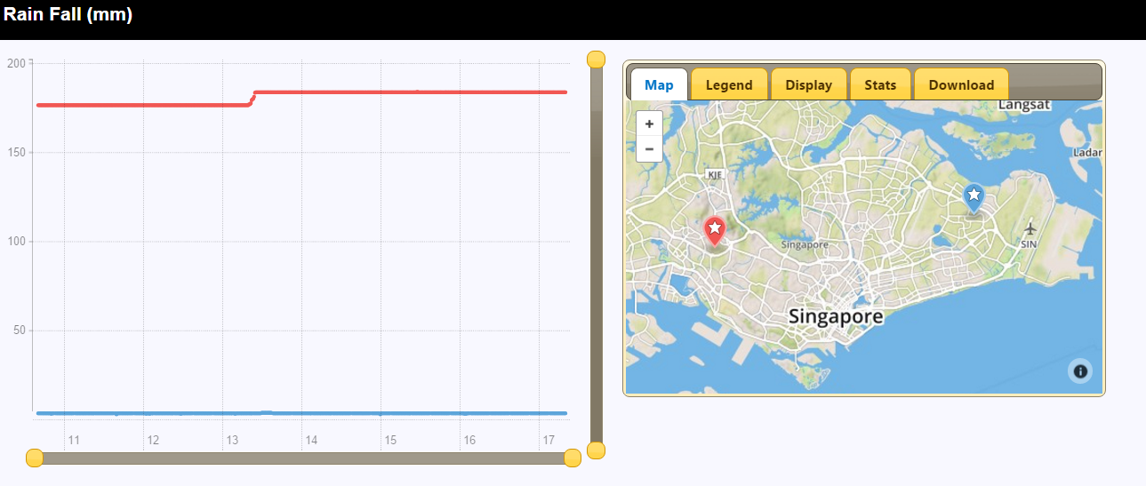
IOT@School
Open pervasive data for schools

Slide 5
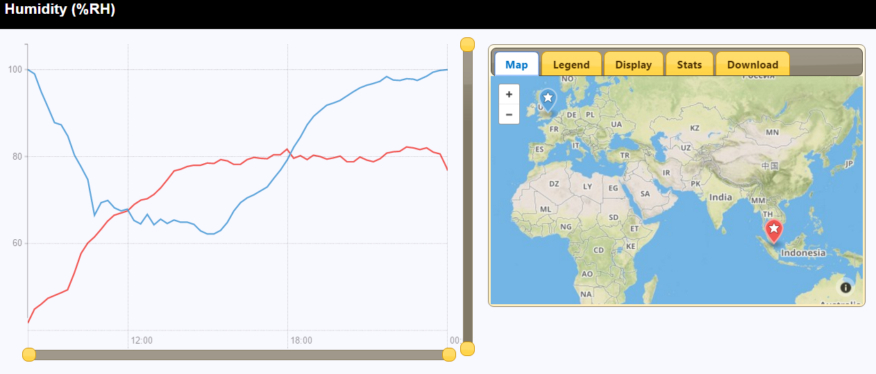
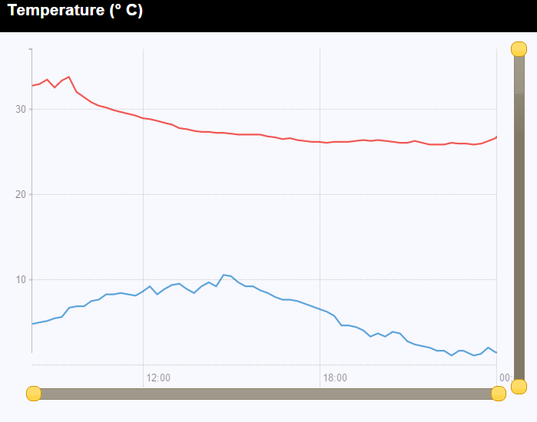
Allowing continuing Analysis by Students
Understanding humidity and how it relates to temperature

Slide 6
Buggy Air
BuggyAir helps parents/carers to understand how ground level air pollution affects their children. Using new sensor technology, BuggyAir measures ground-level air pollution and uses the generated data as evidence for long term behavioural and legislative change.

Slide 7
Buggy Air
THE ISSUE
Today, in many of our cities, children represent the largest subgroup of the population susceptible to the effects of ground level air pollution caused by NO2 (Nitrogen Dioxide), PM (Particulate Matter) and others. Long term health implications include expanded lungs, asthma and significant deterioration in well being. Whilst there is a lot of work being done to measure and take action for air pollution, very little is being done for this specific demographic, which we believe is one the most important group, and needs immediate attention.
WHAT WE HAVE BUILT
We have built a compact air quality monitoring and GPS tracking sensor that can be fitted to a child’s pushchair. The GPS records the precise location of each data point, and an in-built accelerometer intelligently combines with the GPS to determine when a pushchair is being walked around, or is instead travelling in a bus or the back of a car. We are currently trialing the device with parents in London.

Slide 8
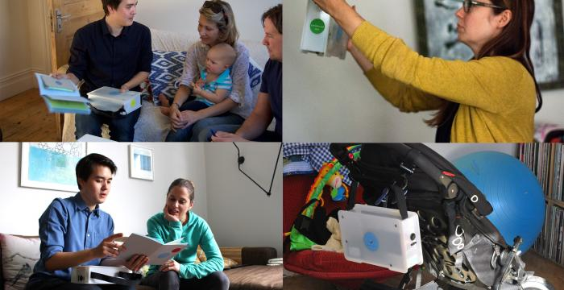
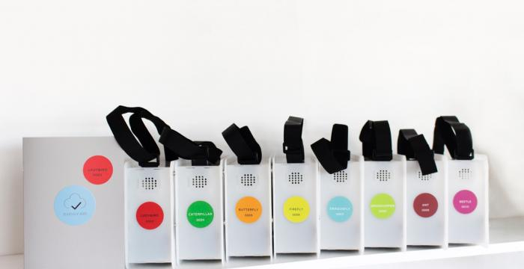
Buggy Air
Measuring key pollutants, Carbon Monoxide, Nitrogen Dioxide and Particulates.

Slide 9
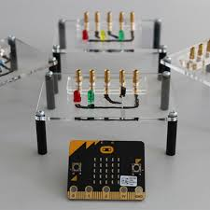
BBC micro:bit
Key features:
In March/April the project will give 1,000,000 devices, one for every 11 year old student in the UK
29 partners have come together to develop and manufacture the devices which will become open source after the distribution
25 LED display
Accelerometer, compass and temperature sensors
2 Buttons

Slide 10
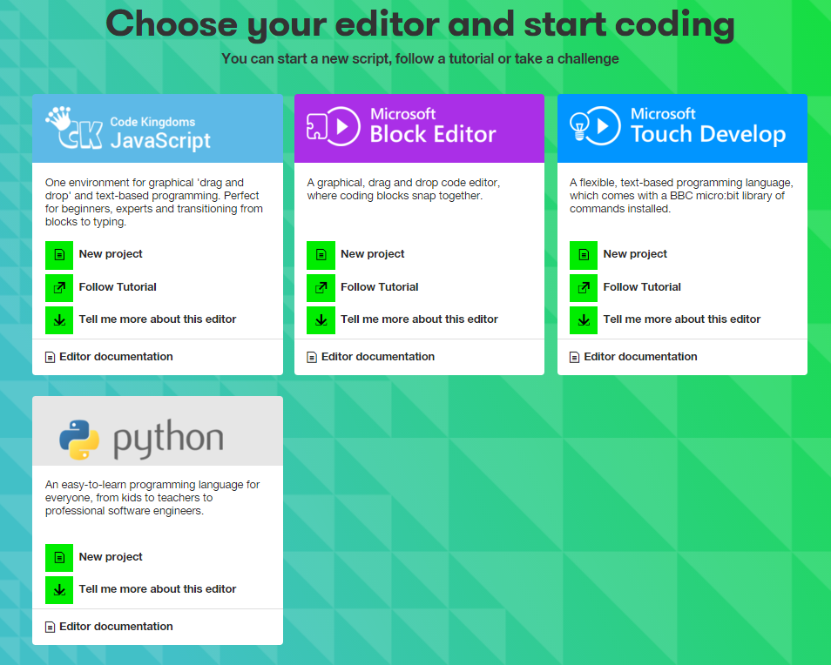
BBC micro:bit
Variety of code editors

Slide 11
BBC micro:bit in Singapore
POC project at Clementi Town Secondary School

Slide 12
If you want to follow up on any of our projects go to http://exploratory.sciencescope.uk/ https://sciencescope.uk/latest-news/ https://www.iotacademy.org/ follow @sciencescope1 email david:@auc.co.uk Q&A

